Slide 1
Mathematical principles of neural networks

Slide 2
The purpose of this slide
Debugging machine learning models is a complex task. By experience, mathematical models don't work as expected the first try.
If it takes so much time to train, it is maybe a good idea to increase the size of a minibatch to reduce the variance in the observations and thus to help the algorithm to converge.
If you observe NaN predictions, the algorithm may have received large gradients producing memory overflow. Think of this as consecutive matrix multiplications that exploit after many iterations. Decreasing the learning rate will have the effect of scaling down these values.

Slide 3
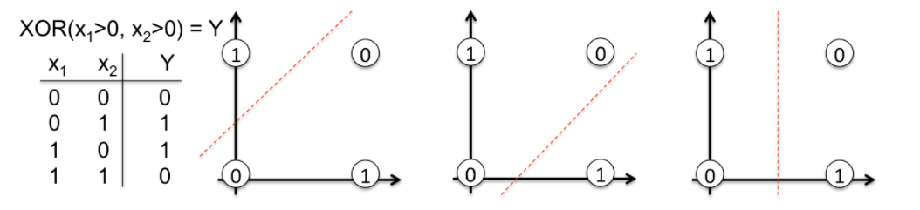
Concrete Example: Learning the XOR Function
Let's open the blackbox. We will build a neural network from scratch that learns the XOR function. The choice of this non-linear function is by no means random chance. Without backpropagation it would be hard to learn to separate classes with a straight line.

Slide 4
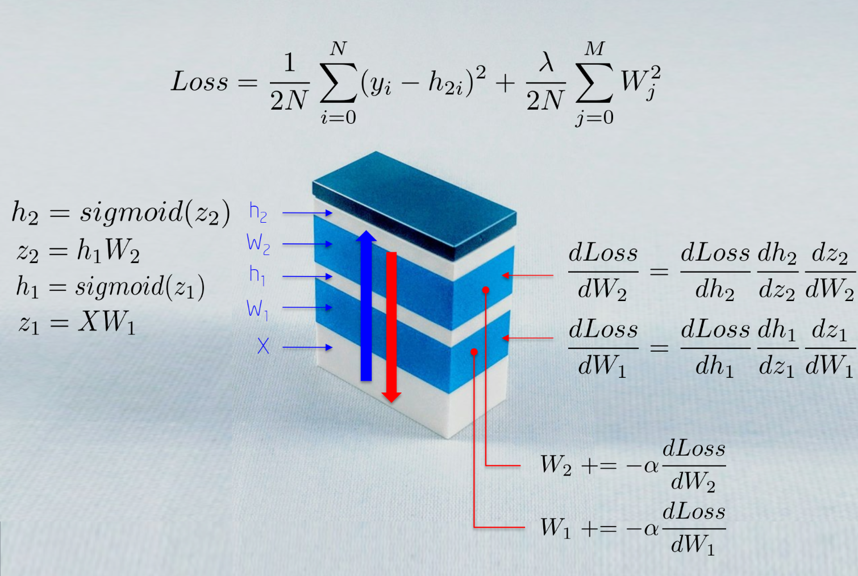
Concrete Example: Learning the XOR Function
The topology of the network is simple:
Input X: is a two dimensional vector
Weights W1: is a 2x3 matrix with randomly initialized values
Hidden layer h1: consists of three neurons. Each neuron receives as input a weighted sum of observations
Weights W2: is a 3x2 matrix with randomly initialized values
Output layer h2: consists of two neurons since the XOR function returns either 0 (y1=[0,1]) or 1 (y2 = [1,0])

Slide 5
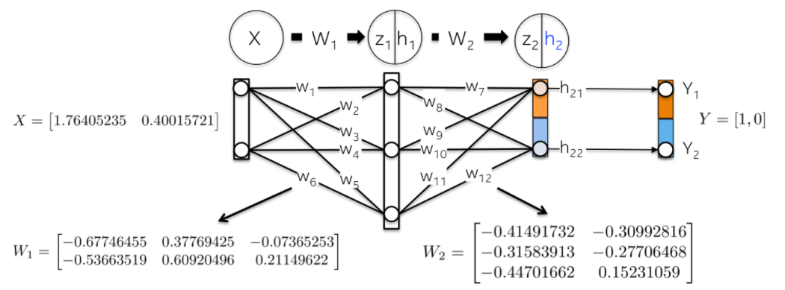
Training nm
Let's now train the model. In our simple example the trainable parameters are weights. First of all, we should initialize the network weights with random numbers.

Slide 6
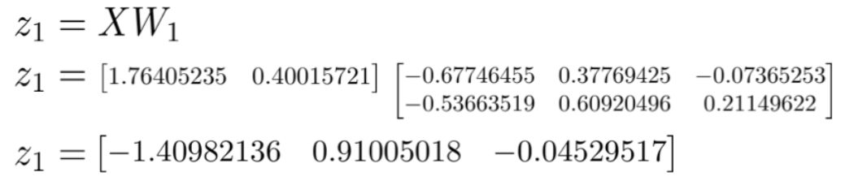
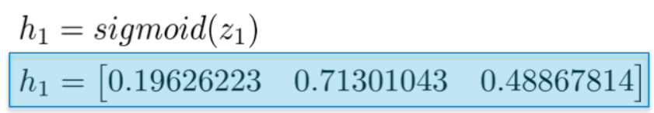
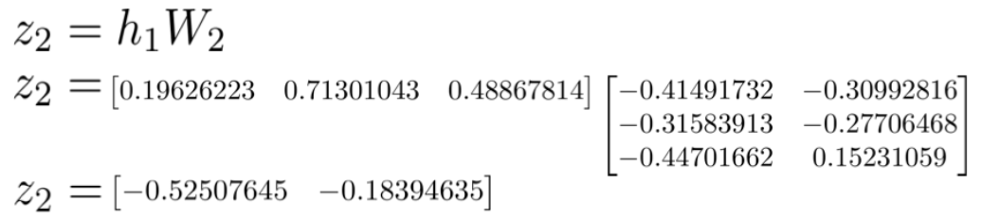
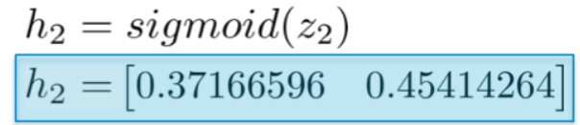
Training nm—Forward Step
Linearly map input X using weights W1 as a kernel:
Scale this weighted sum z1 with a Sigmoid function to get values of the first hidden layer h1. Note that the original 2D vector is now mapped to a 3D space.
A similar process takes place for the second layer h2. Let's compute first the weighted sum z2 of the first hidden layer, which is now input data.
And then compute their Sigmoid activation function. This vector [0.37166596 0.45414264] represents the log probability or predicted vector computed by the network given input X.

Slide 7
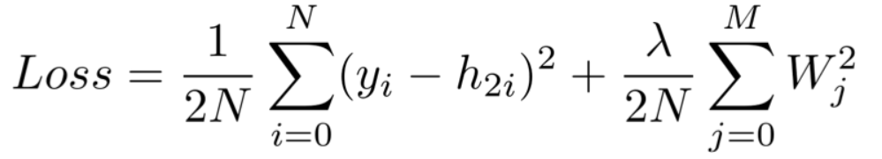
Training model—Computing the Total Loss
The goal of the loss function is to quantify the distance between the predicted vector h2 and the label provided by humans y.
Note that the Loss function contains a regularization component that penalizes large weight values as in a Ridge regression. In other words, large squared weights values will increase the Loss function, an error metric we indeed want to minimize.

Slide 8
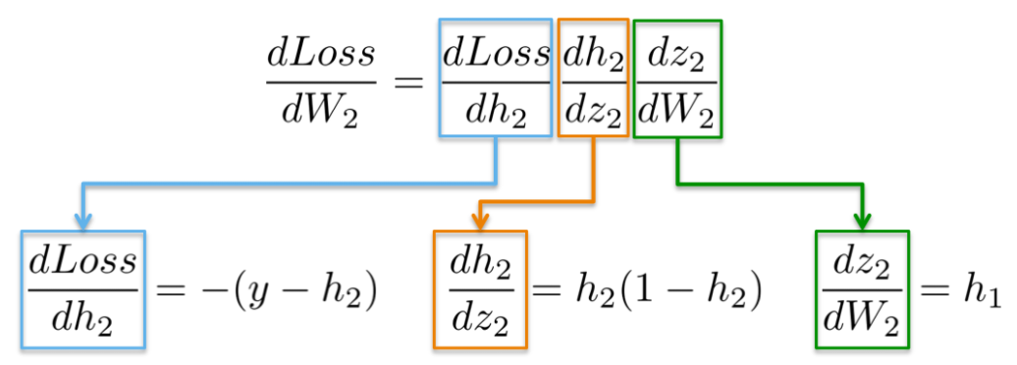
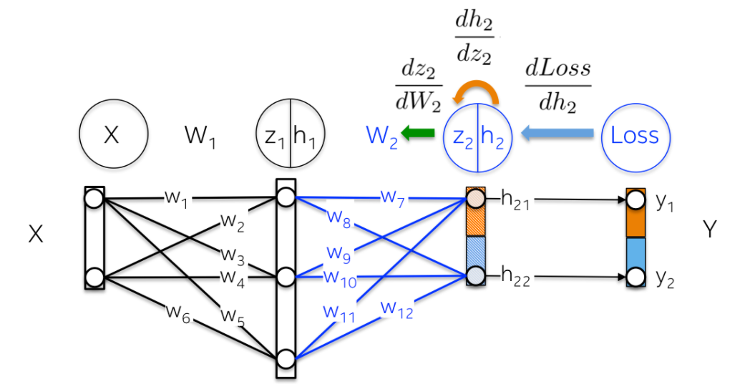
Training model—Backward step
The goal of this step is to update the weights of the neural network in a direction that minimizes its Loss function. As we will see, this is a recursive algorithm, which can reuse gradients previously computed and heavily relies on differentiable functions. It computes first the partial derivative of the loss function with respect to the weights of the output layer (dLoss/dW2) and then the hidden layer (dLoss/dW1). Let's explain in detail each one.
The chain rule says that we can decompose the computation of gradients of a neural network into differentiable pieces.
More visually, we aim to update the weights W2 (in blue) in the below figures. In order to that, we need to compute three partial derivatives along the chain.

Slide 9
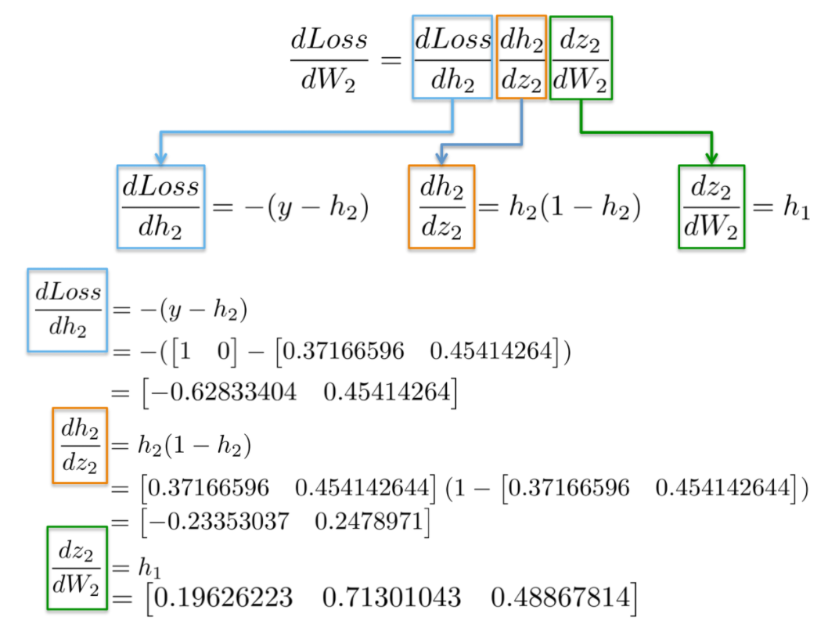
Training model—Backward step
Plugging in values into these partial derivatives allow us to compute gradients with respect to weights W2 as follows.

Slide 10
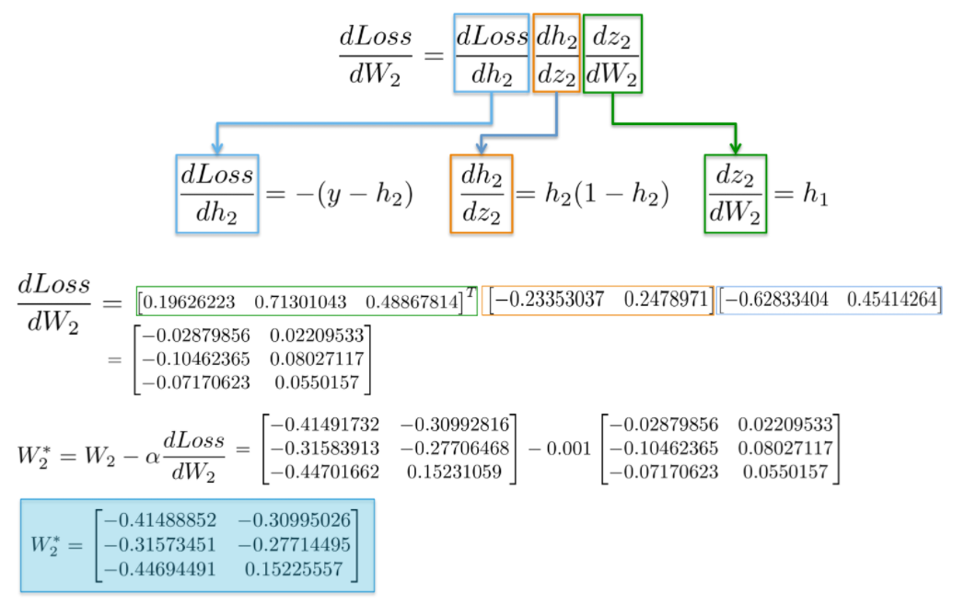
Training model—Backward step
The result is a 3x2 matrix dLoss/dW2, which will update the original W2 values in a direction that minimizes the Loss function.

Slide 11
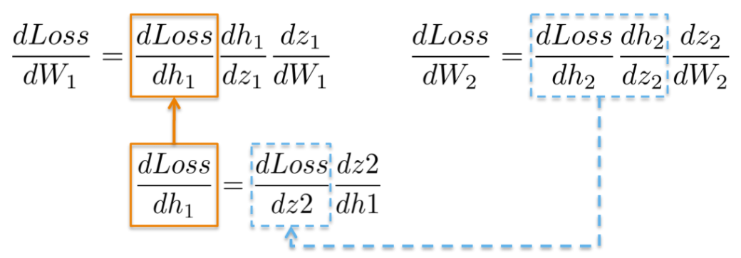
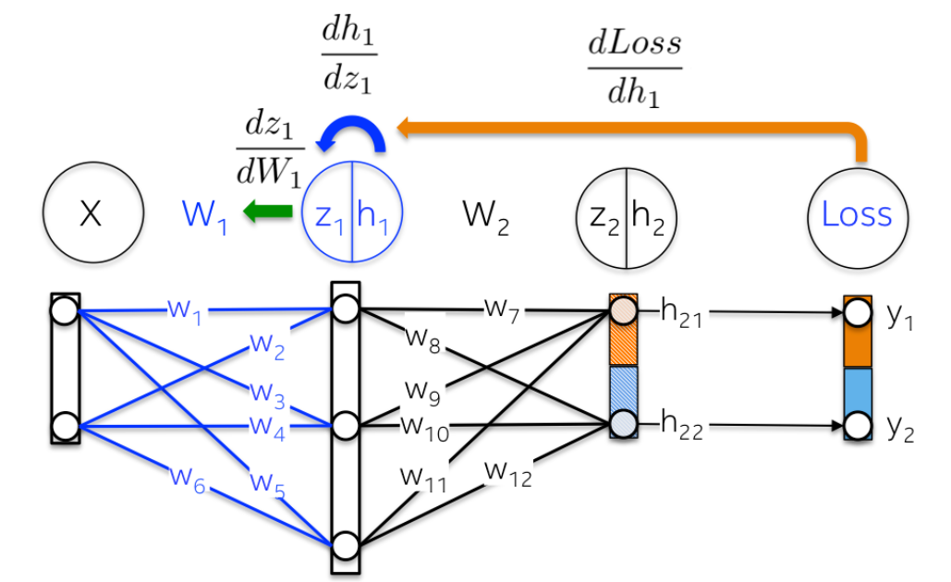
Training model—Backward step
Computing the chain rule for updating the weights of the first hidden layer W1 exhibits the possibility of reusing existing computations.
More visually, the path from the output layer to the weights W1 touches partial derivatives already computed in latter layers.

Slide 12
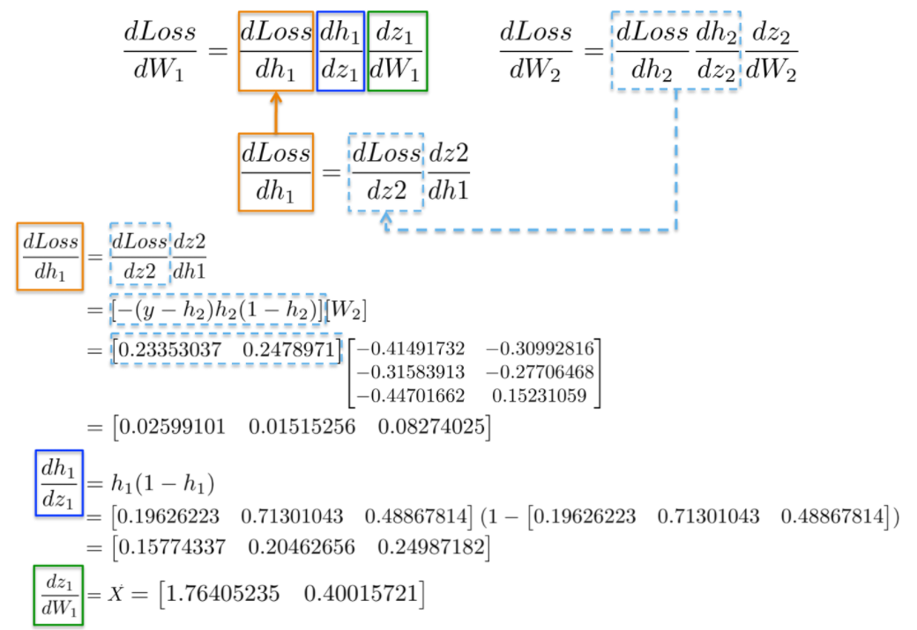
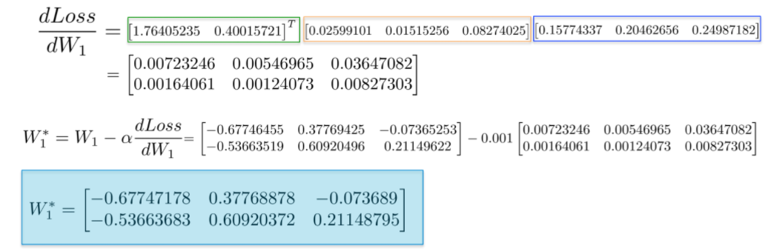
Training model—Backward step
Placing all derivatives together, we can execute the chain rule again to update the weights of the hidden layer W1:

Slide 13
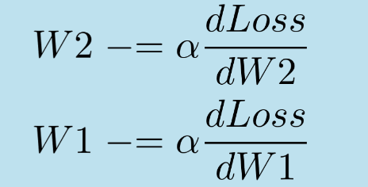
results
Finally, we are ready to update the weights W2 and W1 and complete one iteration during the training of the neural network:
The backpropagation algorithm is responsible for updating the weights of a neural network.
This is a recursive algorithm, which can reuse previous computations of gradient and heavily relies on differentiable functions .
Since these updates reduce the loss function, a network is learning to react this way when seeing similar new patterns.

